Slide 1
ECEN 404:
Active Ankle-
Foot Orthosis (AAFO)
Alfred Boss
Christopher Galik
Tyler Pierce

Slide 2
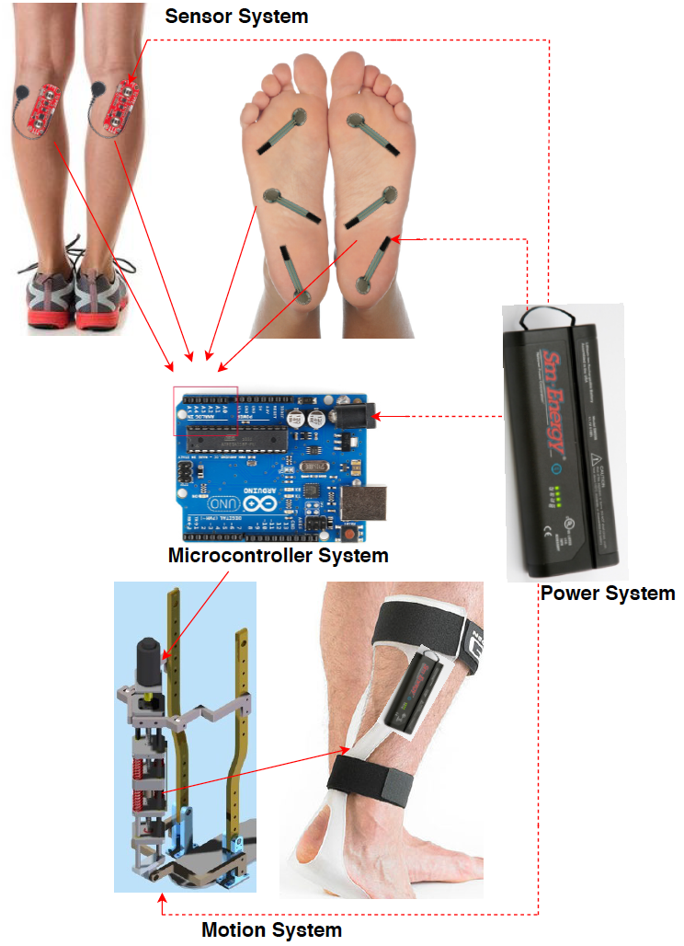
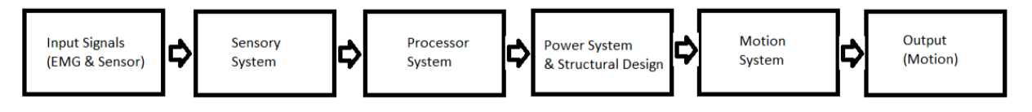
System Overview
EMG sensors and FSR sensors will measure electrical activity and pressure in the leg and foot.
The AAFO will transport signals from the 2 sensors to the MCU.
The microcontroller will interpret signals and determine which stage of gait the user is in and supply corresponding motor control.
The motion system, which acts as an artificial muscle, will move the joint by attaching to a rigid structure.

Slide 3
Sensor & MicroController System
Last Semester Accomplishments
Identified proper locations for two FSR sensors (ball & heel) and 1 EMG sensor (soleus)
Simulated, Designed, and Built circuits to run the sensors
Tested and tweaked all sensors to acquire proper results for all tests
Wrote code for arduino to show sensors function on the system’s microcontroller
Successfully demonstrated all sensors show expected results on the Arduino Uno Rev3
Ongoing progress/problems
Need to understand Polina’s code and confirm it functions properly.
If code does not function properly, then it will need to be tweaked and commented
Need to integrate code with sensors

Slide 4
Artificial Muscle/Motion System Development
Updates
Part replacement for stronger baseline strength
Upcoming
Do power test to ensure smooth integration into the power system
Prep artificial muscle component for integration into the structure

Slide 5
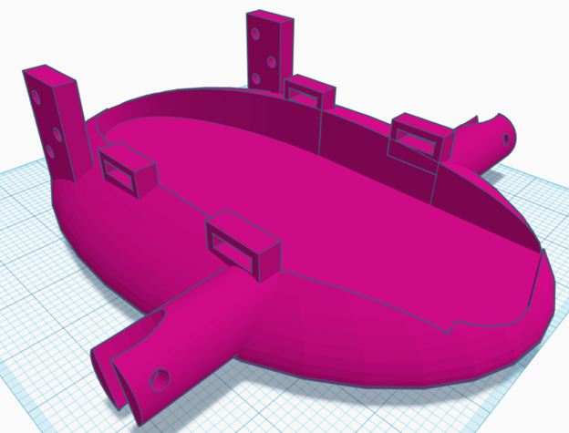
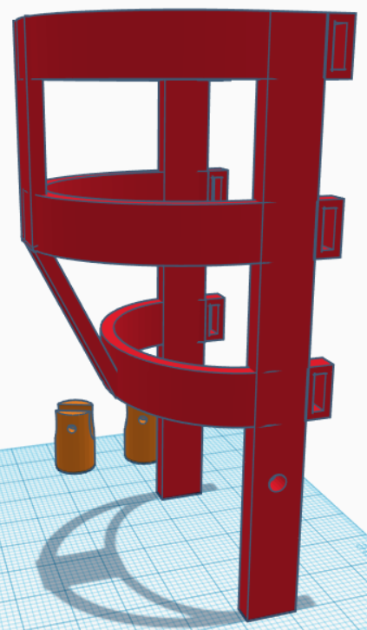
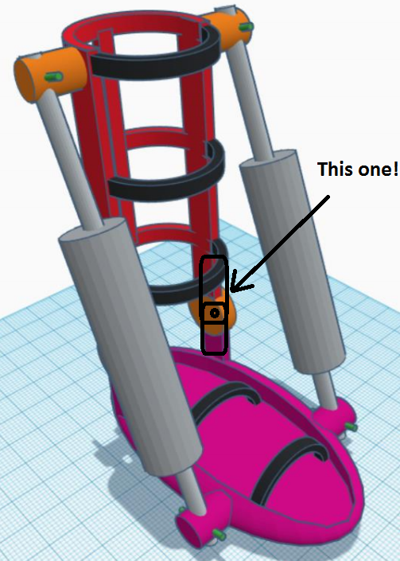
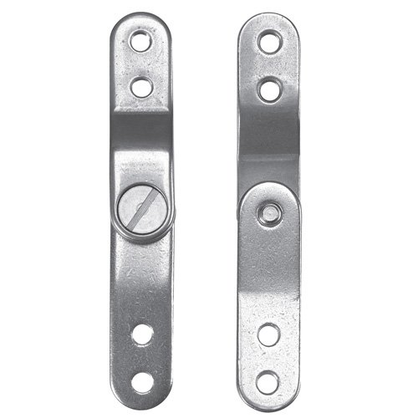
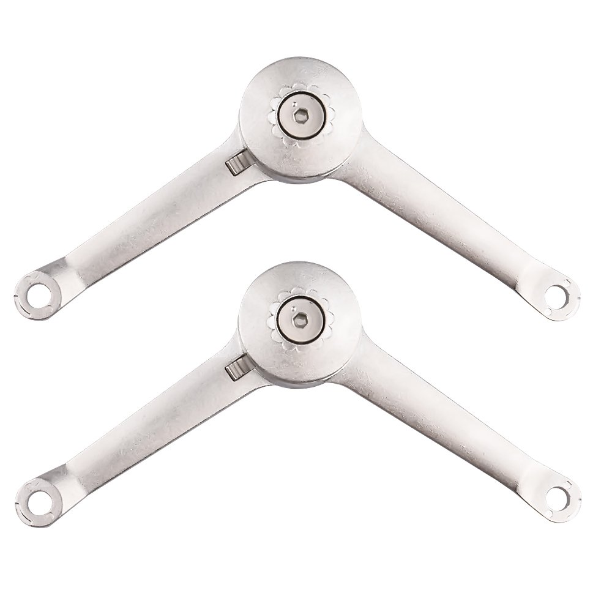
Structural Design
Updates
Dual Artificial Muscle design
Finalized 1st iteration structure design with sponsor
Axis Hinge
Upcoming
Double check measurements
Start 3D printing components today/tomorrow
Validate with stress testing on optical treadmill
Design changes as needed

Slide 6
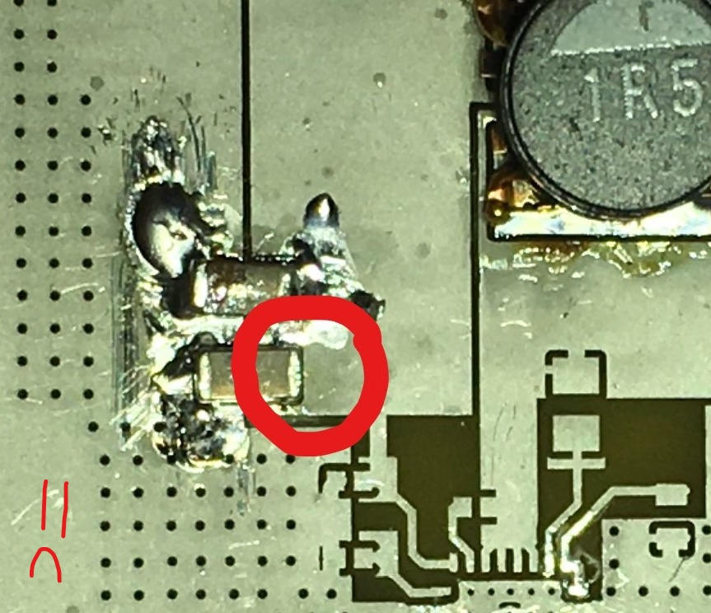
Power System
Updates
Current design is 2 Amps max
Dual Artificial Muscle has doubled power requirements (4 Amps+)
Pad separating ground plane came off during PCB soldering
Upcoming
Research new design for new power requirements
“Ground up” and pre-built options
Notes:
10 pins power req for MC, 0.7A for max current needed for AM, 0.65 minimum, switch solution for speed control

Slide 7
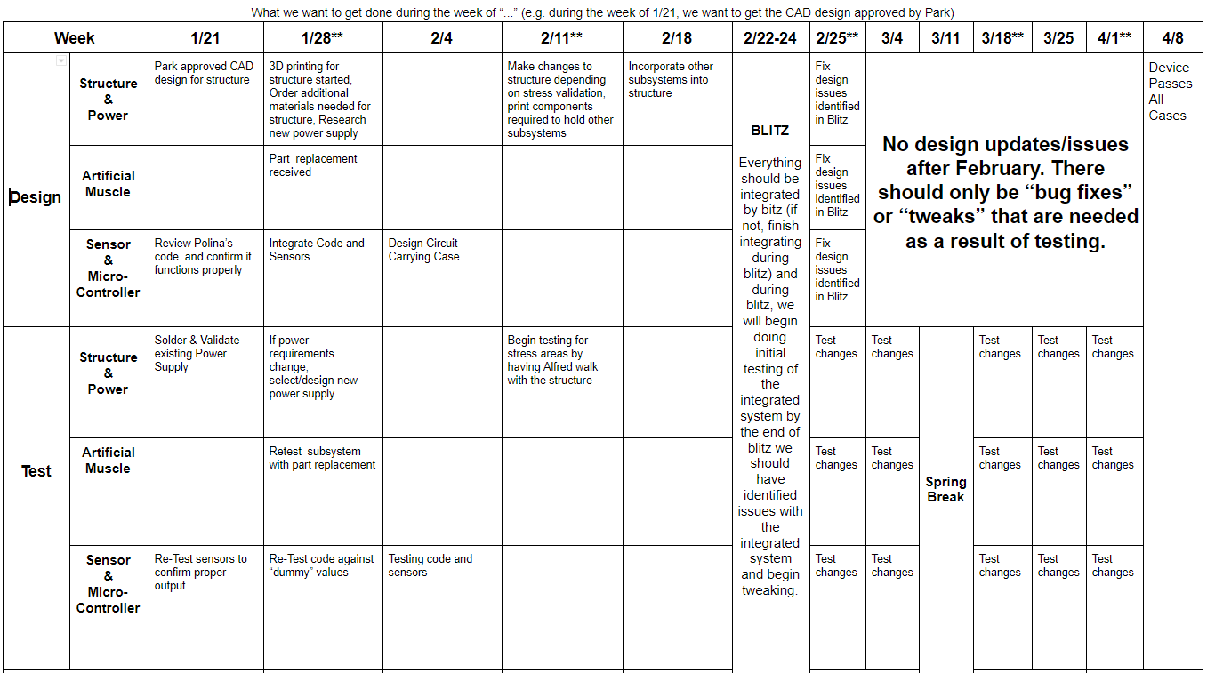


Execution Plan

